Slide 1
Spring Cleaning Workshop
Panorama & Canvas
Presented by Online@JSU
http://www.jsu.edu/online
online@jsu.edu

Slide 2
Agenda
Panorama: Learn more resources
Using DocHub
Remediating PDF basics
Remediating PPT basics
Helpful Tips & Recommendations
Removing old, unpublished Files and Pages
Remove old content from Online@JSU
Refreshing the Accessibility Report

Slide 3
Helpful Tips
Tips for Remediating Content

Slide 4
Helpful Remediation Tips
Follow a consistent process to clean out your course
Remove duplicate files and pages from your course; do not remediate all of them
Remediate low score items (0%) first, and high score items (99%) last.
PDFs – decide whether to remediate, locate alternative version, or replace with another resource
Panorama: Focus on remediating Severe and Major items

Slide 5
Helpful Remediation Tips Continued
Be cautious about remediating font size; it can mess up your document
  Font size is a “minor” issue
Delete any old Pages, Modules, or Templates provided by Online@JSU that are no longer in use and remove from accessibility report
Use Panorama “Learn More” inline information to assist you
Use your Panorama DocHub

Slide 6
Spring Cleaning
Clearing Old, Unpublished Content: Retain or Delete

Slide 7
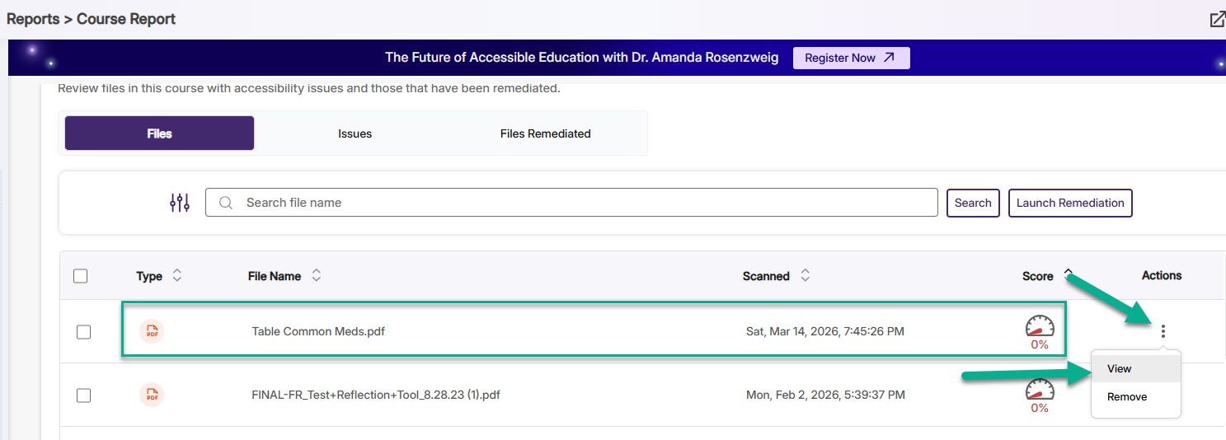
Accessibility Report & Itemized List
Open Course Accessibility Report
Course navigation menu > Panorama
Scroll down page > view the itemized list
Look at the name and score for each item

Slide 8
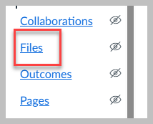
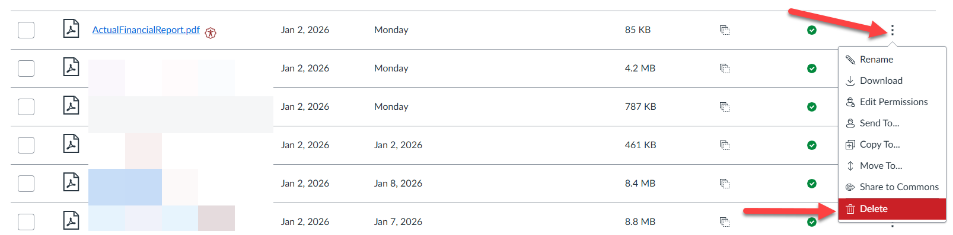
Retain or Delete File
Review Each Item
Old file?
  Delete from Files page

Slide 9
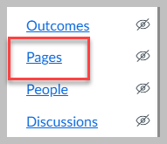
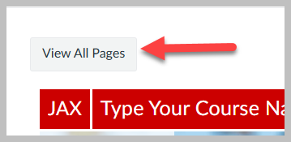
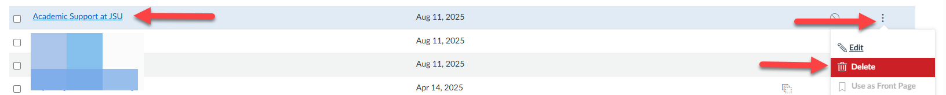
Retain or Delete Page
Review Each Item
Old Page?
  Delete from Pages page

Slide 10
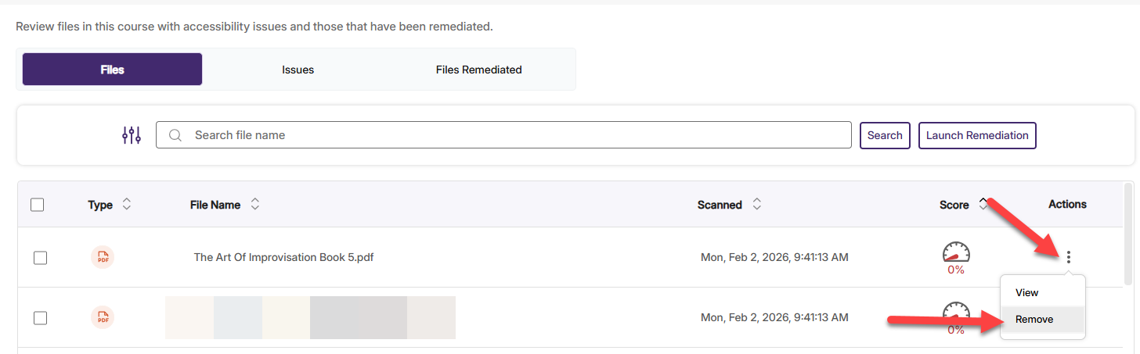
Remove Deleted Items from Report
Remove Deleted Items
Go into Panorama
Scroll down to the itemized list
Find deleted item > click on ellipsis > Remove

Slide 11
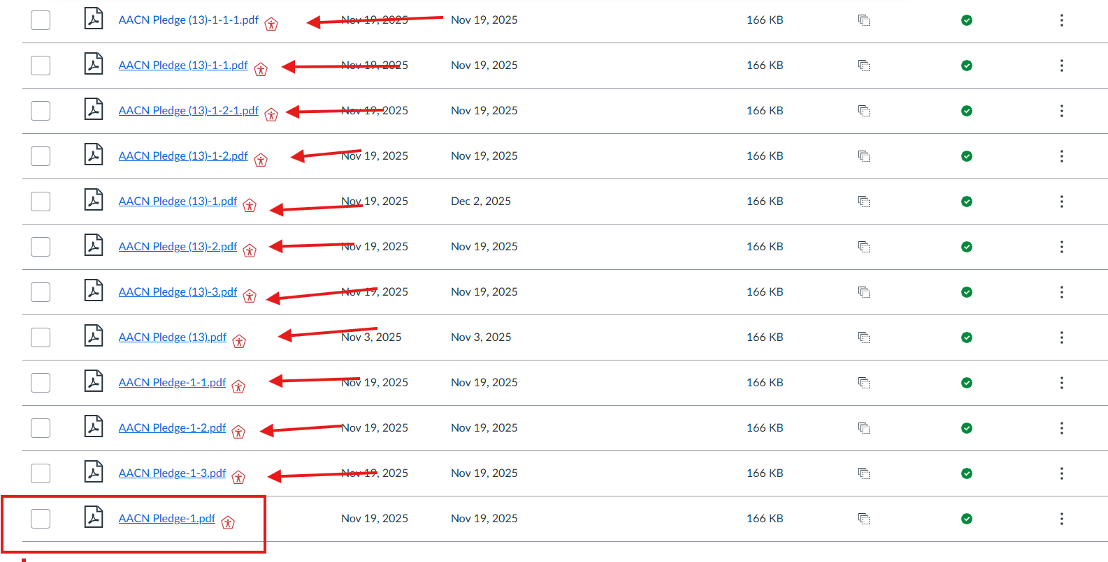
Keep Track
Keep Track of Deleted and Removed Items
How do you track what is deleted so that it can be removed from the report?
Use Snipping Tool
  Screenshot before deletion
  Then Delete
  Then Remove from report

Slide 12
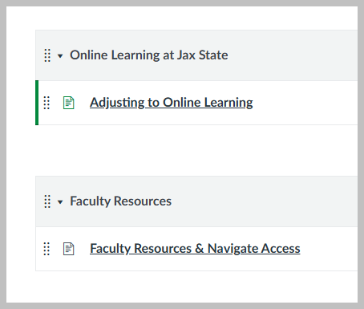
Delete Old Content from Online@JSU
Current Content from Online@JSU
  Online Learning at Jax State
  Faculty Resources
Delete anything else
https://jsu.instructure.com/courses/56496/modules

Slide 13
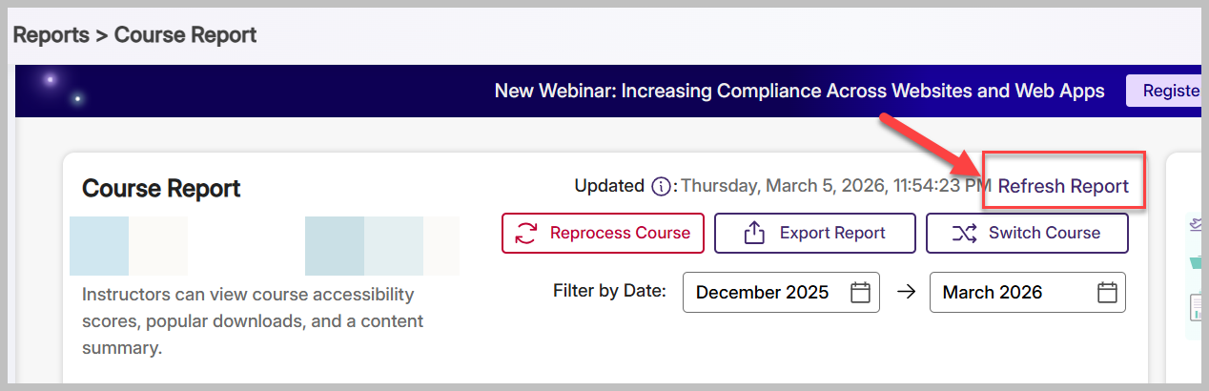
Refresh Report
Refresh Report after Cleaning
Refresh Report after several items have been removed from report
One refresh per hour, so be judicious
Automatic refresh every 24 hours

Slide 14
Spring Cleaning Practice!
Let’s practice identifying, tracking, and deleting content from one of your courses

Slide 15
PDFs & PPTs
Items that cause the MOST issues!

Slide 16
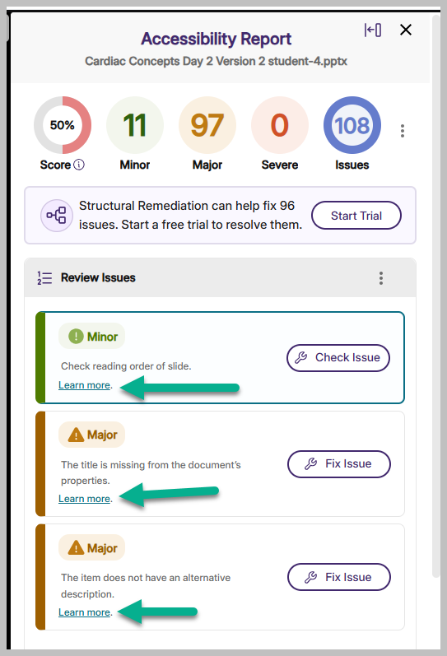
Before We Begin: Learn more in Panorama
Panorama inline remediation > learn more
Demonstrates the issue and how to resolve it (inside or outside of Canvas)
Some content is best remediated outside of Canvas/Panorama
Some content can only be remediated outside of Canvas/Panorama

Slide 17
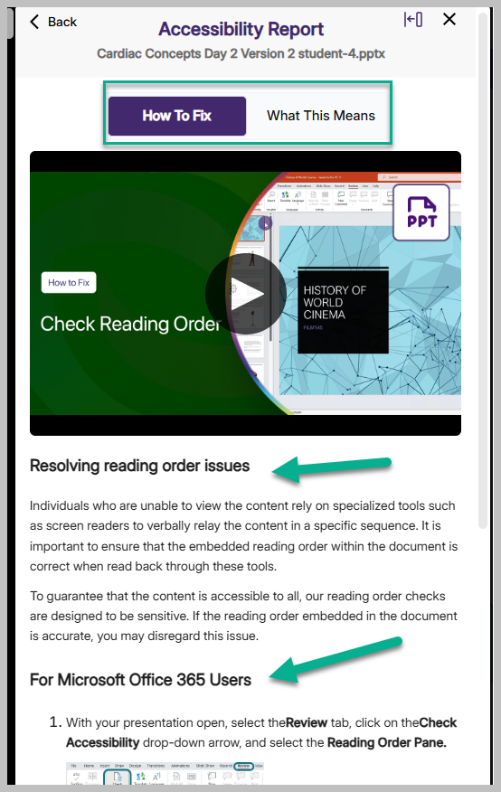
Learn More
How To Fix
What This Means

Slide 18
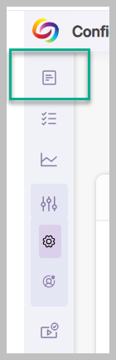
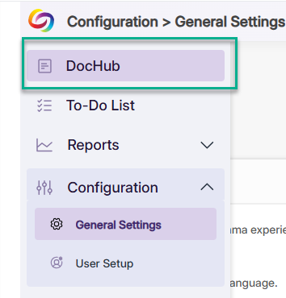
PDF Remediation: Using DocHub
All Faculty have a Panorama DocHub; use it to work on remediating files (PDFs/PPTs/Word)
Located in course report (Panorama)
Open it in separate tab

Slide 19
DocHub Single Sign-On
https://jsu.panorama.yuja.com/login?institution=
Login with MyJaxState Credentials

Slide 20
PDFs: Decisions, Decisions
Article? Replace with permalink from JSU library’s database (if it’s in the database); delete PDF file from course
  Contact Houston Cole Library for assistance with permalinks
From organization? Request accessible version from org
Course Syllabus, Schedule, Calendar, rubrics, etc.? Create accessible, restricted, password-protected Word versions instead
  Make sure the Word document is accessible – use header tags, list tags, table headers, table captions, and give the document a title in document properties
If none of these scenarios apply, remediate in Panorama or Adobe Pro

Slide 21
PDF Remediation: Using DocHub During Remediation
Two common items: untagged PDFs and scanned PDFs
Untagged PDF = OCR Formats > OCR Overlaid PDF
Scanned PDF = OCR Formats > OCR Reconstructed PDF
Third Option: OCR Formats > OCR HTML
Try all three and look at the results!!!

Slide 22
PDF Remediation in Panorama
We are going to create three alternate versions of a PDF, upload them all into DocHub, review them, and attempt to remediate them.
  OCR Overlaid PDF, OCR Reconstructed PDF, OCR HTML
If we can remediate at least one of them in DocHub, we will replace the original PDF in the actual course with the remediated version.
Demonstration & Practice Using DocHub

Slide 23
PPT Remediation in Panorama
Most common issues:
  Slide reading order, Font size, Insufficient contrast between foreground text and background
Remediate in Panorama or in PPT?
  Read flagged issues in Panorama, download PPT, and remediate in PPT using Accessibility Checker
  Then replace the original PPT with remediated PPT; scan again
  Remediating PPT in PPT causes fewer headaches

Slide 24
PPT Creation Tips
Focus on readability over visual appeal
Avoid fancy PPT slide backgrounds that may cause font/background color contrast issues
Make sure all font sizes are 12 pt or higher
Make sure all images have alt text or are marked decorative
Give PPT a title in properties
Use the Accessibility Checker in PPT as you build; check accessibility as you go
Check all publisher-proved PPTs for accessibility; many are not accessible

Slide 25
PPT Remediation Demonstration
PPT Remediation Demonstration & Practice

Slide 26
Thank you from Online@JSU!
Jsu.edu/online
online@jsu.edu
256-782-5699
Monday-Friday / 8:00 am to 4:30 pm

